Slide 1
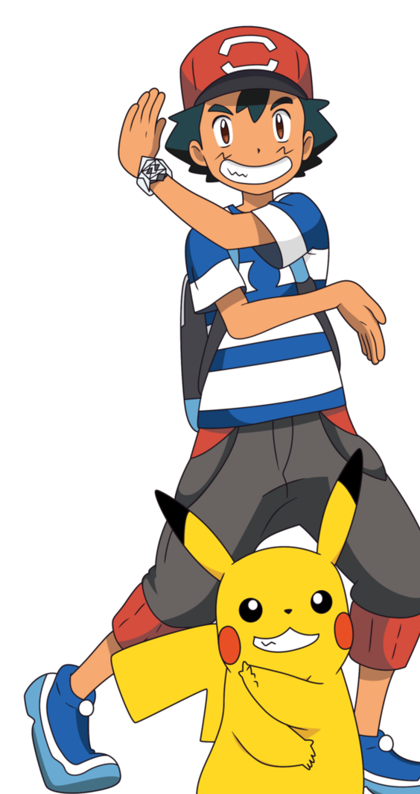
DEMIAN IGNACIO OPAZO

Slide 2
1
2
3
1 x 1 = 1 1 x 2 = 2 1 x 3 = 3 1 x 4 = 4
1 x 5 = 5 1 x 6 = 6
1 x 7 = 7 1 x 8 = 8 1 x 9 = 9 1 x 10 = 10
2 x 1 = 2 2 x 2 = 4 2 x 3 = 6 2 x 4 = 8
2 x 5 = 10 2 x 6 = 12
2 x 7 = 14 2 x 8 = 16 2 x 9 = 18 2 x 10 = 20
3 x 1 = 3 3 x 2 = 6 3 x 3 = 9 3 x 4 = 12
3 x 5 = 15 3 x 6 = 18
3 x 7 = 21 3 x 8 = 24 3 x 9 = 27 3 x 10 = 30
4
5
6
7
4 x 1 = 4 4 x 2 = 8 4 x 3 = 12 4 x 4 = 16
4 x 5 = 20 4 x 6 = 24
4 x 7 = 28 4 x 8 = 32 4 x 9 = 36 4 x 10 = 40
5 x 1 = 5 5 x 2 = 10 5 x 3 = 15 5 x 4 = 20
5 x 5 = 25 5 x 6 = 30
5 x 7 = 35 5 x 8 = 40 5 x 9 = 45 5 x 10 = 50
6 x 1 = 6 6 x 2 = 12 6 x 3 = 18 6 x 4 = 24
6 x 5 = 30 6 x 6 = 36
6 x 7 = 42 6 x 8 = 48 6 x 9 = 54 6 x 10 = 60
7 x 1 = 7 7 x 2 = 14 7 x 3 = 21 7 x 4 = 28
7 x 5 = 35 7 x 6 = 42
7 x 7 = 49 7 x 8 = 56 7 x 9 = 63 7 x 10 = 70

Slide 3
8
9
10
11
8 x 1 = 4 8 x 2 = 8 8 x 3 = 12 8 x 4 = 16
8 x 5 = 20 8 x 6 = 24
8 x 7 = 28 8 x 8 = 32 8 x 9 = 36 8 x 10 = 40
9 x 1 = 9 9 x 2 = 18 9 x 3 = 27 9 x 4 = 36
9 x 5 = 45 9 x 6 = 54
9 x 7 = 63 9 x 8 = 72 9 x 9 = 81 9 x 10 = 90
10 x 1 = 10 10 x 2 = 20 10 x 3 = 30 10 x 4 = 40
10 x 5 = 50 10 x 6 = 60
10 x 7 = 70 10 x 8 = 80 10 x 9 = 90 10 x 10 = 100
11 x 1 = 11 11 x 2 = 22 11 x 3 = 33 11 x 4 = 44
11 x 5 = 55 11 x 6 = 66
11 x 7 = 77 11 x 8 = 88 11 x 9 = 99 11 x 10 = 110
12
13
14
15
12 x 1 = 12 12 x 2 = 24 12 x 3 = 36 12 x 4 = 48
12 x 5 = 60 12 x 6 = 72
12 x 7 = 84 12 x 8 = 96 12 x 9 = 108 12 x 10 = 120
13 x 1 = 13 13 x 2 = 26 13 x 3 = 39 13 x 4 = 52
13 x 5 = 65 13 x 6 = 78
13 x 7 = 91 13 x 8 = 104 13 x 9 = 117 13 x 10 = 130
14 x 1 = 44 14 x 2 = 28 14 x 3 = 42 14 x 4 = 56
14 x 5 = 70 14 x 6 = 84
14 x 7 = 98 14 x 8 = 112 14 x 9 = 126 14 x 10 = 140
15 x 1 = 15 15 x 2 = 30 15 x 3 = 45 15 x 4 = 60
15 x 5 = 75 15 x 6 = 90
15 x 7 = 105 15 x 8 = 120 15 x 9 = 135 15 x 10 = 150

