Slide 1


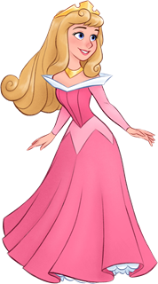





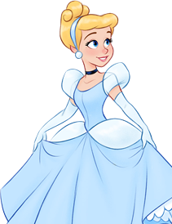
ANTONIA IGNACIA OPAZO
Notes:
Mas Horarios Escolares en: www.robnei.blog

Slide 2

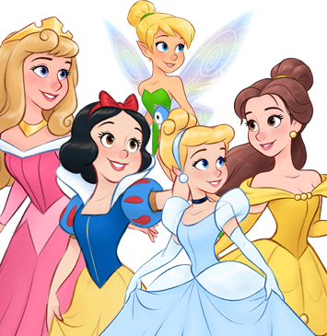


1
2
3
1 x 1 = 1
1 x 2 = 2
1 x 3 = 3
1 x 4 = 4
1 x 5 = 5
1 x 6 = 6
1 x 7 = 7
1 x 8 = 8
1 x 9 = 9
1 x 10 = 10
2 x 1 = 2
2 x 2 = 4
2 x 3 = 6
2 x 4 = 8
2 x 5 = 10
2 x 6 = 12
2 x 7 = 14
2 x 8 = 16
2 x 9 = 18
2 x 10 = 20
3 x 1 = 3
3 x 2 = 6
3 x 3 = 9
3 x 4 = 12
3 x 5 = 15
3 x 6 = 18
3 x 7 = 21
3 x 8 = 24
3 x 9 = 27
3 x 10 = 30
4
5
6
7
4 x 1 = 4
4 x 2 = 8
4 x 3 = 12
4 x 4 = 16
4 x 5 = 20
4 x 6 = 24
4 x 7 = 28
4 x 8 = 32
4 x 9 = 36
4 x 10 = 40
5 x 1 = 5
5 x 2 = 10
5 x 3 = 15
5 x 4 = 20
5 x 5 = 25
5 x 6 = 30
5 x 7 = 35
5 x 8 = 40
5 x 9 = 45
5 x 10 = 50
6 x 1 = 6
6 x 2 = 12
6 x 3 = 18
6 x 4 = 24
6 x 5 = 30
6 x 6 = 36
6 x 7 = 42
6 x 8 = 48
6 x 9 = 54
6 x 10 = 60
7 x 1 = 7
7 x 2 = 14
7 x 3 = 21
7 x 4 = 28
7 x 5 = 35
7 x 6 = 42
7 x 7 = 49
7 x 8 = 56
7 x 9 = 63
7 x 10 = 70
Notes:
Mas Horarios Escolares en: www.robnei.blog

Slide 3
8
9
10
11
8 x 1 = 4
8 x 2 = 8
8 x 3 = 12
8 x 4 = 16
8 x 5 = 20
8 x 6 = 24
8 x 7 = 28
8 x 8 = 32
8 x 9 = 36
8 x 10 = 40
9 x 1 = 9
9 x 2 = 18
9 x 3 = 27
9 x 4 = 36
9 x 5 = 45
9 x 6 = 54
9 x 7 = 63
9 x 8 = 72
9 x 9 = 81
9 x 10 = 90
10 x 1 = 10
10 x 2 = 20
10 x 3 = 30
10 x 4 = 40
10 x 5 = 50
10 x 6 = 60
10 x 7 = 70
10 x 8 = 80
10 x 9 = 90
10 x 10 = 100
11 x 1 = 11
11 x 2 = 22
11 x 3 = 33
11 x 4 = 44
11 x 5 = 55
11 x 6 = 66
11 x 7 = 77
11 x 8 = 88
11 x 9 = 99
11 x 10 = 110
12
13
14
15
12 x 1 = 12
12 x 2 = 24
12 x 3 = 36
12 x 4 = 48
12 x 5 = 60
12 x 6 = 72
12 x 7 = 84
12 x 8 = 96
12 x 9 = 108
12 x 10 = 120
13 x 1 = 13
13 x 2 = 26
13 x 3 = 39
13 x 4 = 52
13 x 5 = 65
13 x 6 = 78
13 x 7 = 91
13 x 8 = 104
13 x 9 = 117
13 x 10 = 130
14 x 1 = 44
14 x 2 = 28
14 x 3 = 42
14 x 4 = 56
14 x 5 = 70
14 x 6 = 84
14 x 7 = 98
14 x 8 = 112
14 x 9 = 126
14 x 10 = 140
15 x 1 = 15
15 x 2 = 30
15 x 3 = 45
15 x 4 = 60
15 x 5 = 75
15 x 6 = 90
15 x 7 = 105
15 x 8 = 120
15 x 9 = 135
15 x 10 = 150
Notes:
Mas Horarios Escolares en: www.robnei.blog

